Slide 1


Slide 2
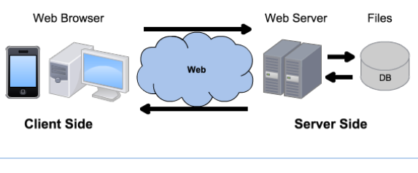
Linux
Windows
MacOS
Android
Linux
Windows Server
Apache
Tomcat
IIS
NodeJS+Express
MySQL
Oracle
SQL Server
MongoDB
Chrome
Firefox
Safari
HTTP
HTTPS
HTML
CSS
JavaScript
PHP
Java
ASP
JavaScript
Bootstrap
SQL
JSON
jQuery
Notepad++
Eclipse
Visual Studio

Slide 3

Express.js
Express.js, or simply Express, is a fast, unopinionated, minimalist web framework for Node.js: http://expressjs.com/
It is the de facto standard: dominant position by public acceptance or market forces.
It is free and open-source, under the MIT License.
It is designed for building web applications and APIs.
npm install express

Slide 4
api.js
var express = require("express");
var http = require("http");
var app = express();
// Create our Express-powered HTTP server and have it listen on port 8080
http.createServer(app).listen(8080);
// set up our routes
app.get("/hello", function (req, res) {
// no need to set up HTTP headers
res.send("Hello World!");
}); // simply using res.send instead of res.write and res.end
app.get("/goodbye", function (req, res) {
res.send("Goodbye World!");
});
app.get("/", function (req, res) {
res.send("This is the root route!");
});

Slide 5




Routes
node server.js
localhost:8080/
localhost:8080/hello
localhost:8080/goodbye
ctrl + c

Slide 6
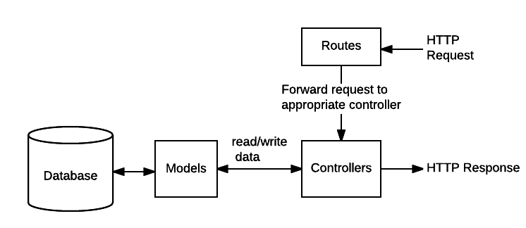
Web API Architecture

Slide 7
Static files
// configure the app to use the view directory for static files
app.use(express.static(__dirname + "/view"));
// __dirname is where your server script is located
Any request sent to our server will initially be resolved by the static file directory view before it is handed off to our routes.
If we have a file called index.html in our view directory, and we go to localhost:8080/index.html, it will return the contents of the file.
If the file doesn’t exist, it will then check to see if there’s a match among our routes.
Sending static files more generally:
res.sendFile(path.join(__dirname + 'view/' + filename));

Slide 8
Web API with Express
Routing is determining how an application or API responds to a client request to a particular endpoint, which is a URI (or path), and a specific HTTP request method (GET, POST, PUT, DELETE).
Express supports methods corresponding to all HTTP request methods.
Only the first match of each route (endpoint + method) will be called initially. But each route can have one or more handler functions. These can be chained when the route is matched, and even cause the control flow to go to a ‘next’ route.
Router functions are Express middleware, which means that they must either complete (respond to) the request, e.g. res.send(), or call the next function or route in the chain.
Notes:
https://expressjs.com/en/guide/routing.html

Slide 9
Web API with Express
Route definition structure:
app.method(PATH, HANDLERs)
app is an instance of express.
method is an HTTP request method, in lowercase.
PATH on the server. Can be strings, string patterns, or regular expressions.
Query strings are not part of the route path.
You can access them in Express via req.query.q
HANDLER is the callback function executed when the route is matched.
You can also use app.all() to handle all HTTP methods.

Slide 10
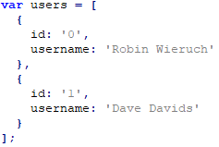

Web API with Express
Say 'users' is your JS array of users:
With one handler:
app.get('/users', function (req, res) {
res.json(users);
});

Slide 11
Web API with Express
With multiple handlers:
var cb1 = function (req, res, next) {
if (!authenticated)
next('route'); // bypass the next handlers and go to the next route
next(); // pass control to the next handler specified in the array, cb2
}
var cb2 = function (req, res) {
return res.json(users);
}
app.get('/users', [cb1, cb2]);
/* you can use this mechanism to respect the “single responsibility” and “don’t repeat yourself” principles and reuse handlers */
Notes:
The handlers listed in the array can use next('route'); to pass control to subsequent routes if there’s no reason to proceed with the current route.

Slide 12
Web API with Express
Route parameters are named URL segments that are used to capture the values specified at their position in the URL.
The captured values are populated in the req.params object, with the name of the route parameter in the path as the key.
The name of route parameters must be made up of [A-Za-z0-9_].
Request URL: http://localhost:3000/users/1
Route path: /users/:userId
req.params: { "userId": "1" }
app.get('/users/:userId', function (req, res) {
res.json(users[req.params.userId]);
// returns the JSON representation of the object in position 1
// {"id":"1","username":"Dave Davids"}
});

Slide 13
Web API with Express
Resource/identifier/resource
app.get('/users/:userId/books', function (req, res) {
res.send("All the books of user " + req.params.userId);
// TODO find all the books of that user and send them
});
Resource/identifier/resource/identifier
req.params: { "userId": "0", "bookId": "1" }
app.get('/users/:userId/books/:bookId', function (req, res) {
res.send("Book " + req.params.bookId + " of user " + req.params.userId);
// TODO find that book of that user and sent it
});
Force the identifier to be a number
Route path: /users/:userId(\\d+)
If it’s not, you will receive a message like: Cannot GET /users/a

Slide 14
Web API with Express
// before any routes are defined:
app.use(express.json());
// parses text as JSON and exposes the object on req.body. Don’t double it with JSON.stringify
app.use(express.urlencoded({ extended: true }));
// for forms, parses text as URL encoded data and exposes the object on req.body.
Say your client sends a request like $.post("/users", { id: '2', username: 'John Doe' });
app.post('/users', function (req, res) {
users.push(req.body); // TODO persist the data
res.send("Received");
});
app.put('/users/:userId', function (req, res) {
// TODO update the user and reply back
});
app.delete('/users/:userId', function (req, res) {
// TODO delete the user and reply back
});

Slide 15
REST API Design Conventions
Keep your base URL simple and intuitive, with only singular or plural concrete nouns for resources and only 2 base URLs per resource:
/users and /users/1
Relationships between resources: /resource/identifier/resource
GET /users/1/books
Put optional states and attributes (“sweep complexity”) behind the HTTP question mark:
GET /users?location=dublin&car=no

Slide 16
REST API Design Conventions
Support partial response (to save bandwidth, especially for mobile) by adding optional fields in a comma-delimited list:
/users?fields=name,car,location
Pagination (e.g. get records 50 to 75)
/users?limit=25&offset=50
Use verbs for “non-resource” URLs:
/convert?from=EUR&to=USD&amount=100
Use a few HTTP status codes for error handling (200 – OK, 400 – Bad Request, 500 - Internal Server Error) with detailed descriptions in the payload, e.g.:
{"type" : "OauthException", "message":"(#803) Some of the aliases you requested do not exist: foo.bar"}

Slide 17
Questions?

